Slide 1
Lariat Rent-A-Car Car Rental Fleet Analysis
Capstone I Stephanie Kirk

Slide 2





Rental Car Fleet 2018 Takeaways
Where are we now?
Where can we go from here?
Branches
50
Rental Cars
4000
Rental Days
325,608
Revenue
$52,830,207
Profit
$19,753,518

Slide 3


Objective
Develop strategies for minimizing cost and maximizing revenue
Cost
Revenue
Increase Rentals
Increase Price
Sale/Purchase of Rental Cars

Slide 4

Strategy 1: Increase Business by 25%
66% increase in Revenue
25% increase in Profit

Slide 5

Strategy 2: Increase Price by 10%
No increase in cost
No increase in Business

Slide 6

Strategy 3: Sell and Purchase Cars for fleet
Improved Fleet Composition
30% Increase in Total Profit

Slide 7

Strategy 4: Combined Strategies
Sale/Purchase of Fleet Vehicles
25% Increase in Business
10% increase in Price

Slide 8
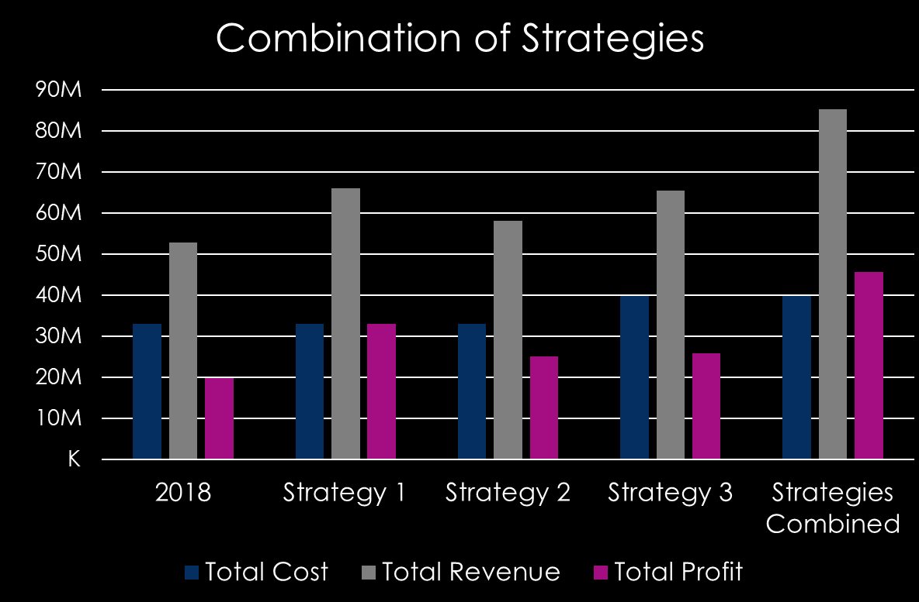

Recommendation: Combination
81,402 additional rental days
61% increase in Revenue
130% increase in Profit
Increased Revenue
Increased Profit
Increased Rentals
Increased Price Per Rental

